Slide 1
Coronavirus Perception and Evolution
Term Project - Web Data & Digital Analytics
F. Boeglin, A. Chabaud, K. Donmez, R. Hug

Slide 2

AG
EN
DA
01
Introduction – Coronavirus under the Loop
02
Network Analysis – Worldwide Air Routes
03
Text Mining – Countries’ Reactions
04
Conclusion & Limitations
Notes:
© Copyright Showeet.com

Slide 3

How can we use network analysis and text mining to analyze the perception and evolution of Coronavirus?
By using available information about the spread of the Coronavirus and the measures taken by different countries, we try to see :
Network analysis: what are the similarities between the spread of the virus and the structure of worldwide air routes?
Text Mining: how did the overall sentiment about this pandemic evolve over time, and what were different countries’ reactions?
By combining our findings, we develop conclusions about the perception and evolution of Coronavirus between selected countries.
Introduction

Slide 4
Network Analysis
The Data
The Analysis
OpenFlights – 2012
59,036 routes
3,209 airports
531 airlines
Directed network
Modeling the network
Hubs
Comparison with Coronavirus map

Slide 5
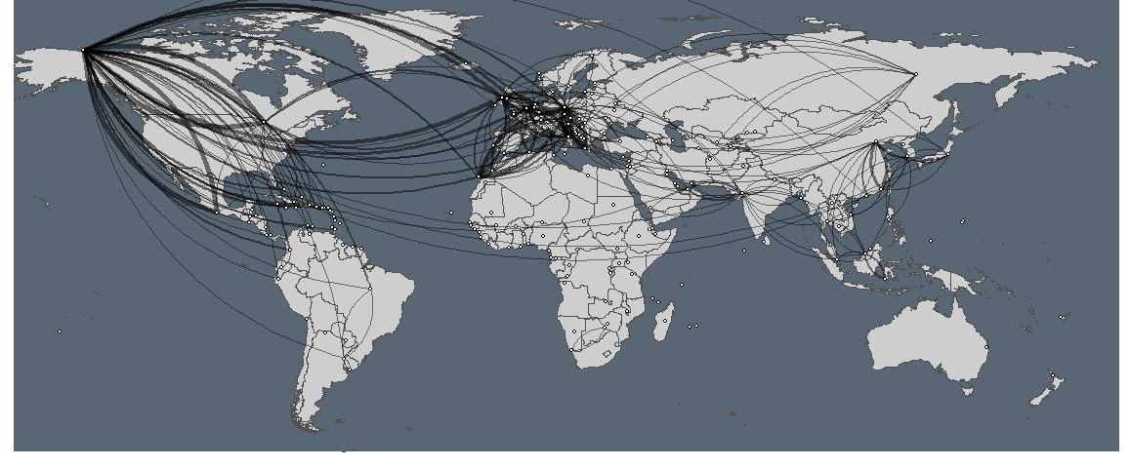
Modeling
Worldwide air routes
Very heavy database: originally listing the connections between airports, by airlines; grouped by country
Weight of connection: same connection from different airports
Representation: only the connections with weight > 5; width of the edges represents weight
Observations: Graph density is 0.214, but some areas seem more connected
Mediterranean basin
Europe-US
US-Central America
South-East Asia

Slide 6
Hubs
Central countries for worldwide air routes
Hubs Ranking
United States | 1
Germany | 0,764852
United Kingdom | 0,700827
France | 0,605118
Canada | 0,590904
Italy | 0,583538
Mexico | 0,498101
Spain | 0,465886
Greece | 0,264316
Morocco | 0,143263
Austria | 0,132506
Netherlands | 0,112909
Algeria | 0,106361
Switzerland | 0,10193
COVID-19 Cases per one million population*
Spain | 5661
Ireland | 4657
Belgium | 4612
United States | 4133
Singapore | 4072
Italy | 3623
Switzerland | 3502
United Kingdom | 3229
France | 2711
Portugal | 2705
Sweden | 2606
Belarus | 2530
Netherlands | 2488
Germany | 2051
In line with model visualization: mostly countries in Mediterranean basin + United States & Mexico
Apparent similarity with COVID-19 cases: 8 of the 14 most touched countries are also among the top 14 worldwide hubs
*Of countries with a population over four million; China and Iran excluded
As of 11 May 2020 10:39 GMT
Source: worldometer

Slide 7
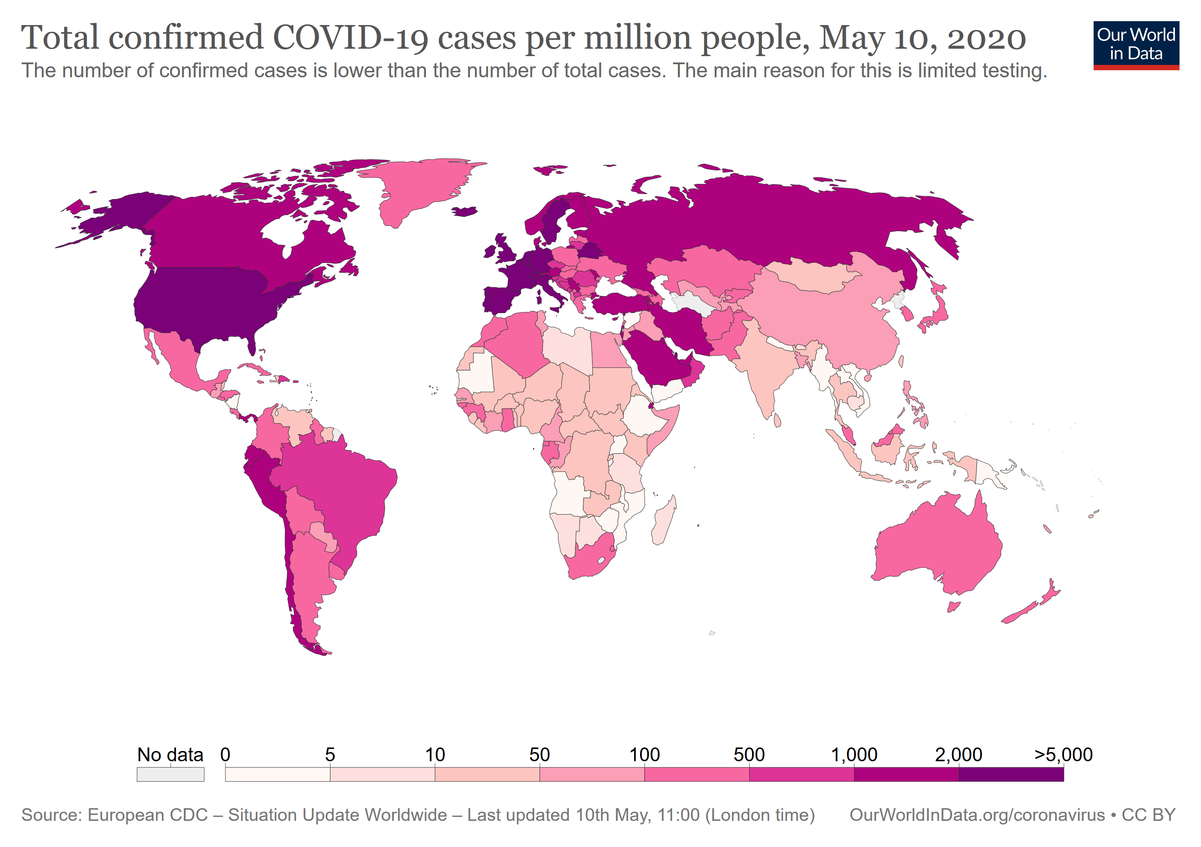
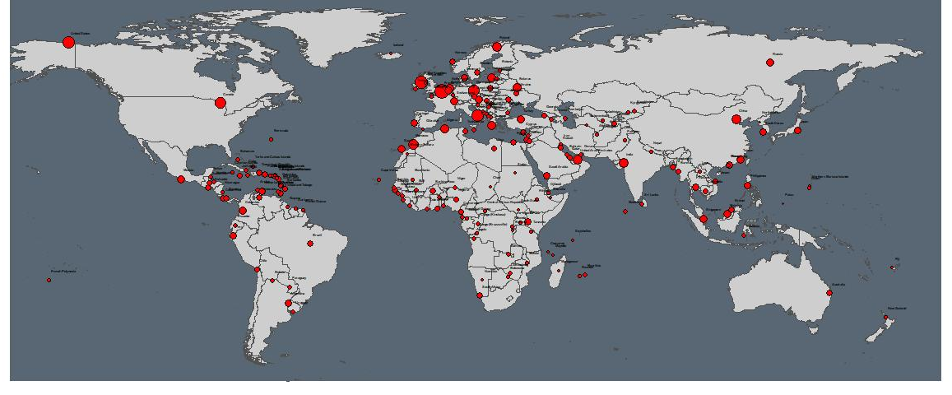
Map Comparison
Inferences by comparing the two maps
Similarities: in general, it seems that there is some correlation between the worldwide air routes and the spread of the Coronavirus
Multitude of factors: there are many factors that explain the spread, and the worldwide air routes are only one aspect
Limitations: our model presents limitations, as our data is static & older vs. a dynamic & constant evolution of the pandemic
Countries for text mining: choice of countries based on this network analysis
US: main hub and strongly touched
Germany: second biggest hub, but not too strongly touched
UK: third hub and interesting change of strategy

Slide 8
Text Mining
The Data
The Analysis
Opinion leaders’ tweets from selected countries
US, UK, Germany
A politician, a national influencer, a news media
Measures of the three countries
Sentiment analysis over time
Comparison between opinion leaders in each country
Comparison across countries

Slide 9
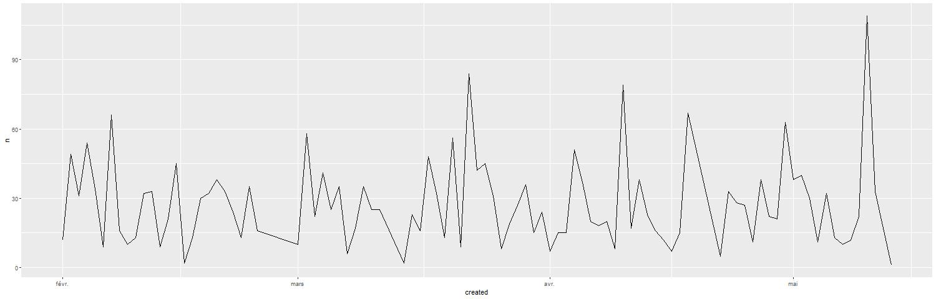


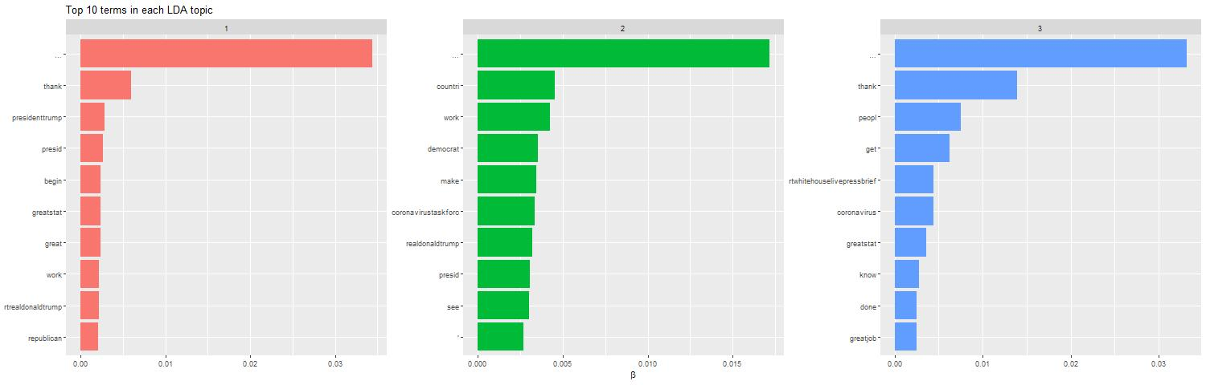
Sentiment Analysis
Procedure
Collecting the data:
Limitation in tweet numbers; challenge of finding people who tweet enough but not too much and who are opinion leaders for the country
Taking only tweets between February 1st and May 12th
Sometimes taking retweets when interesting
Analyzing and exporting the data:
Sentiment evolution over time for each person
General and polarized wordcloud for each person to check for main words
Topic analysis for each person to make sure that Coronavirus is at least one main topic
Aggregated sentiment evolution and polarized wordcloud for countries comparison
Comparing and making inferences:
Keeping in mind our limitations
Dynamic evolution; spread of the virus inside the country and actions taken over time
All the graphs are in the appendix

Slide 10
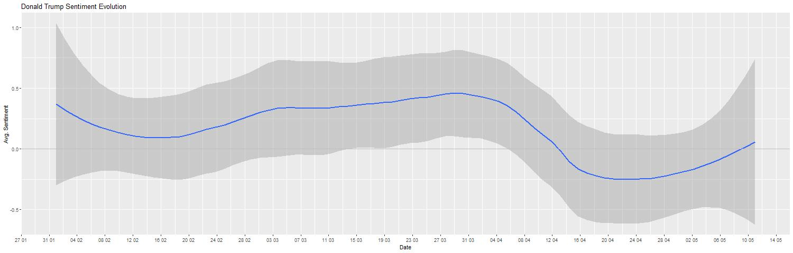
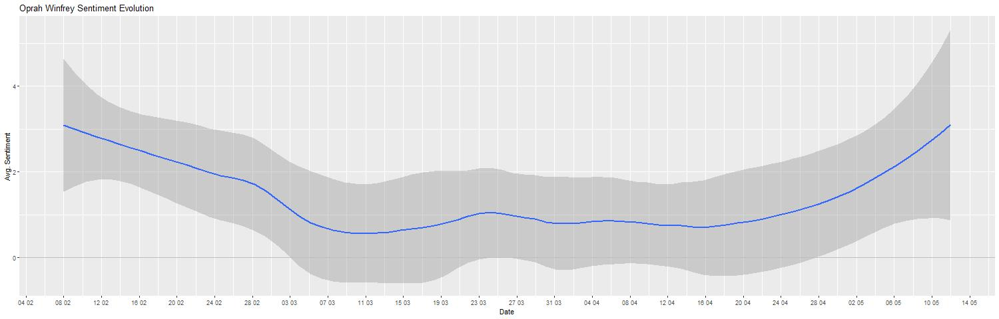
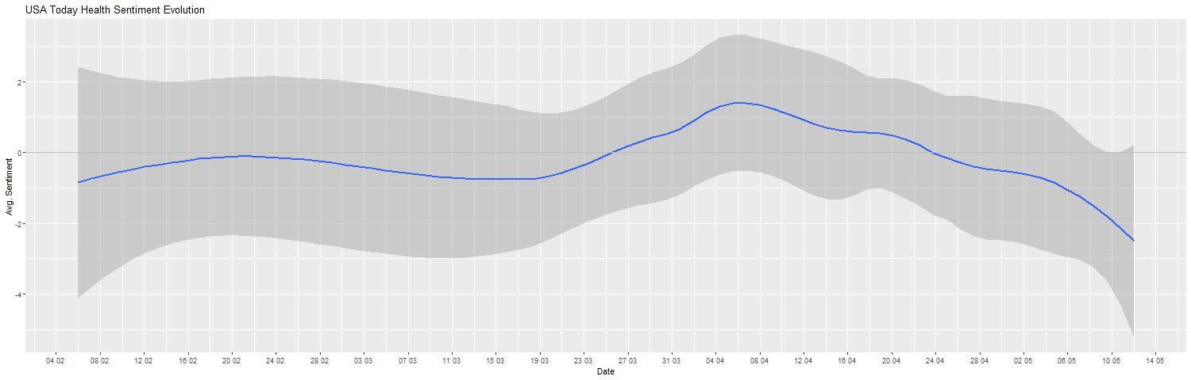
4
United States
1
2
Opinion Leaders’ Level
3
5
OBSERVED PERSONS
Trump (with retweets) – sentiment values are close to 0
Oprah Winfrey (with retweets) – highest sentiment values
USA Today Health – sentiment is most of the times below 0
SENTIMENT EVOLUTION
Sentiment evolution of Donald Trump continuously increases after end of February while Oprah Winfrey and USA Today Health sentiment evolution goes down
Sentiment of Donald Trump and Oprah Winfrey goes up after denial of immigration; sentiment of USA Today health goes down
IMPORTANT POINTS IN TIME/POSSIBLE TURNING POINTS
First COVID-19 case confirmed
US CDC warns that the spread to the United States is likely and that people should prepare
WHO declares COVID-19 as a pandemic
States start to cancel gatherings of more than 250 people
Donald Trump announces he will temporarily suspend immigration to the US for 60 days by executive order.
Notes:
Important → Looking at the evolutiono and not at the numbers themselves. We compare the sentiment evolution. .
Similarities:
At point three → US wanr thet the spread of COVID is likely and people should prepare → Oprah and USA Today health sentiment evolution goes down → are aware of the situation. It looks different when looking at the graph of donald trump → sentiment goes in an upward directioon
Differences:
The three sentiment graphs are distinct from one another
First COVID-19 case confirmed (21 januar)
US CDS wanrs taht the sperad to the united states is likely and that people should prepare february 25
WHO declares COVID-19 as a pandemic (11. März)
States start to cancel gatherings of more then 250 people
Donald Trump announces he will temporarily suspent immigration to the unitesd States for 60 days by executive order.

Slide 11

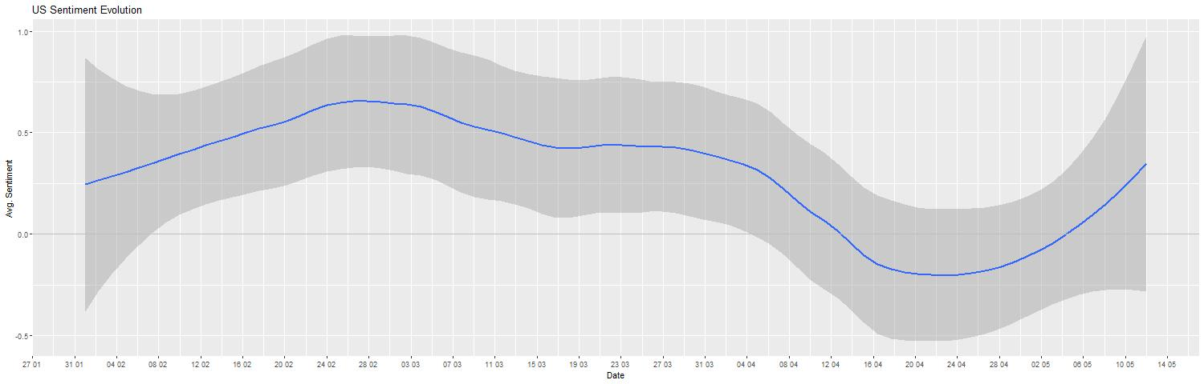
United States
Country’s Level
New daily cases seem to have an inverse relationship with daily sentiment
The sentiment decrease can be seen starting before the virus started growing
Wordcloud shows “fake” (comes from Donald Trump) and “hard”, as well as “strong”, “protect” and “support”

Slide 12
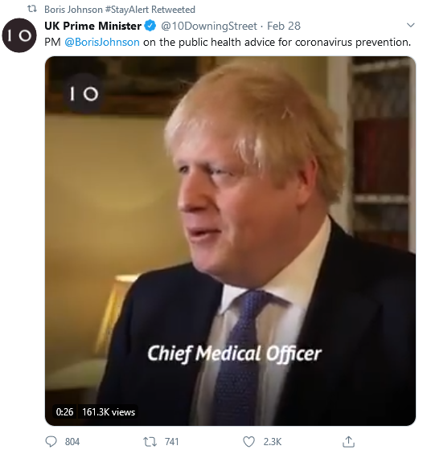
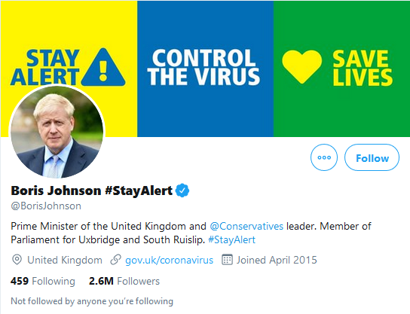
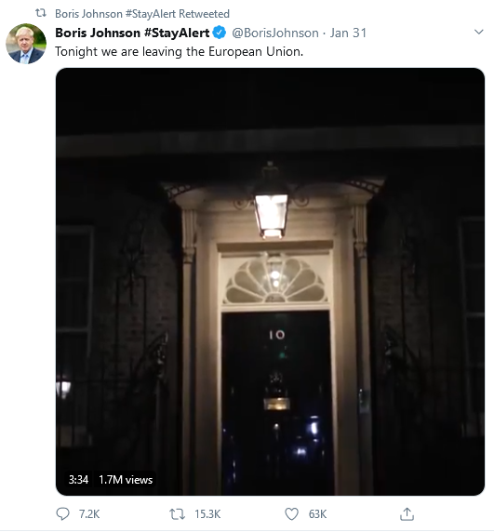
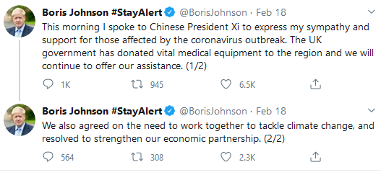
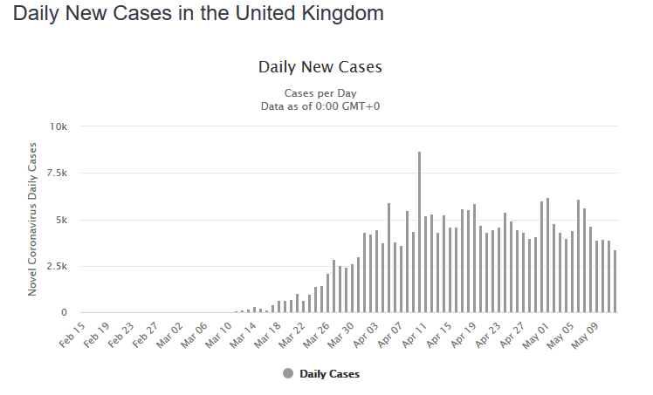
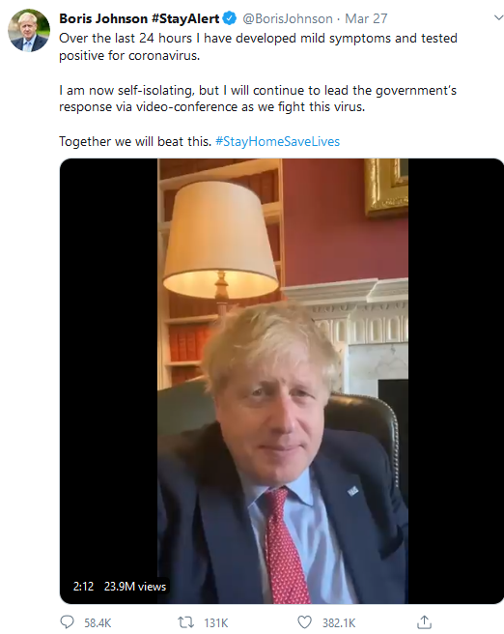
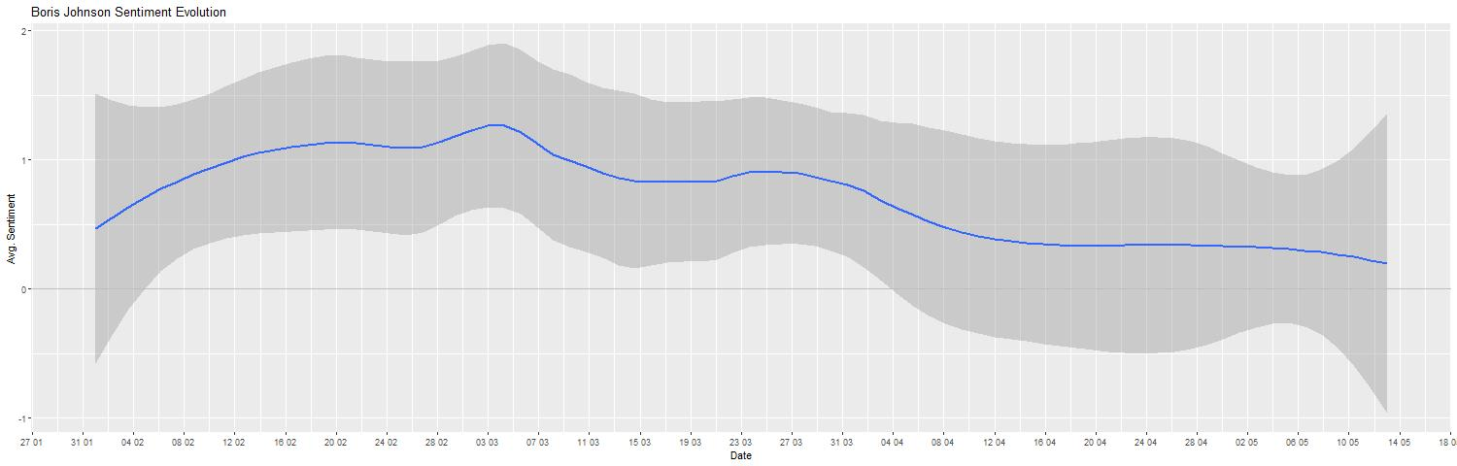

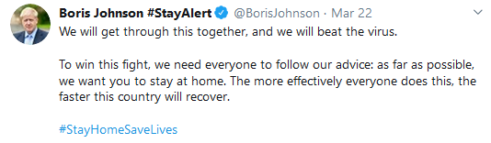
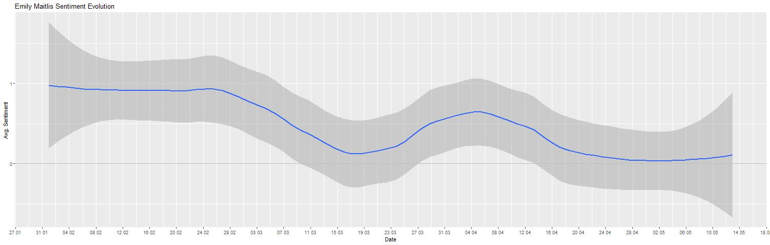
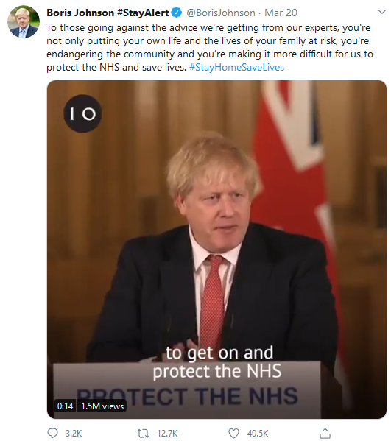
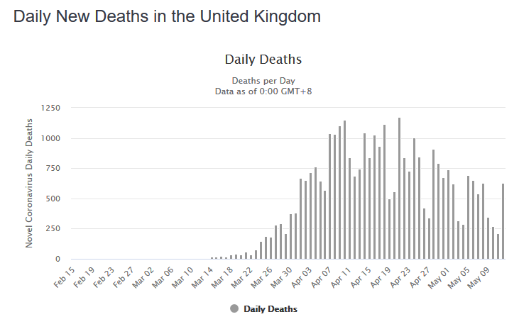
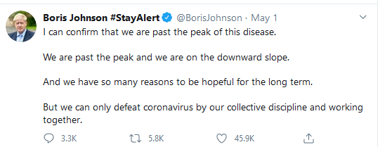
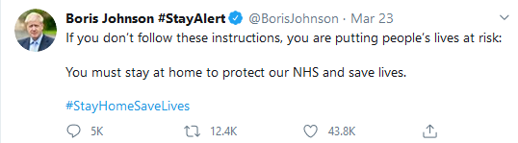
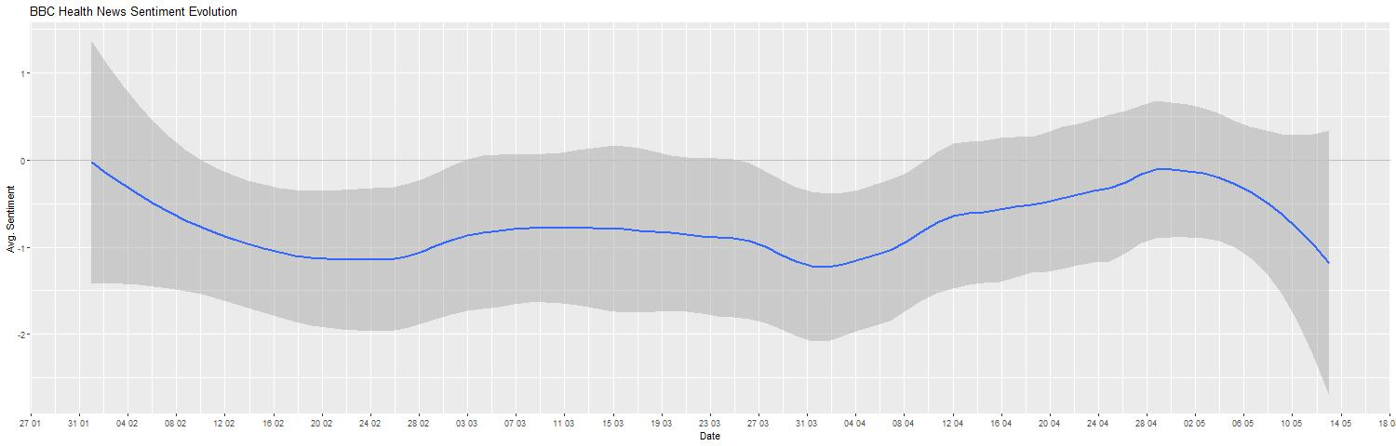
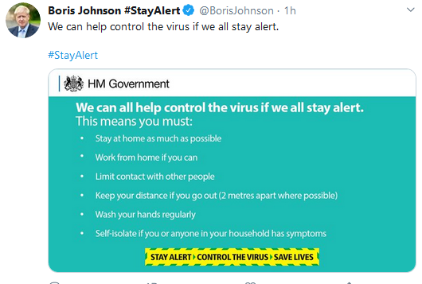
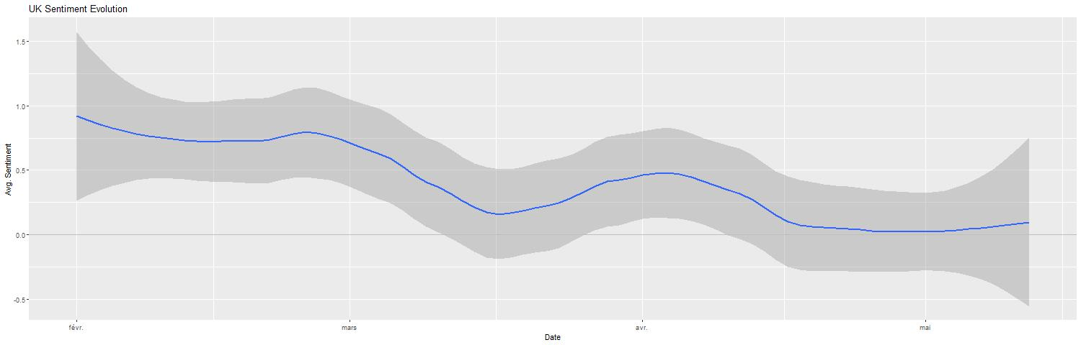
4
United Kingdom
1
2
Opinion Leaders’ Level
3
5
OBSERVED PERSONS
Boris Johnson – sentiment goes up and then gradually decreases
Emily Maitlis – compared to the others, high starting point and with time close to 0
BBC Health News – always below 0
SENTIMENT EVOLUTION
Emily Maitlis’ sentiment evolution develops against the direction of the others (beginning of April)
Beginning of April, sentiment of Boris Johnson goes gradually down
BBC health decreases and then increases again mid March; it sinks again after May
BBC’s sentiment increases when Boris’ and Emily’s gradually goes down
IMPORTANT POINTS IN TIME/POSSIBLE TURNING POINTS
First COVID-19 case confirmed
WHO declares COVID-19 as a pandemic
Declaration that the coronavirus constitutes a serious and imminent threat to public health
UK advises citizens against all but essential international travel and strongly starts advising social distancing
Lockdown
Notes:
It is interesting to see, that the sentimen of boris johnson goes up, altou already one person in the uk is tested positiv on corona → concluede about the
https://www.worldometers.info/coronavirus/country/uk/
Emily Mathis asentiment evolution develops against the direction of the other (beginning of April)
The strongest ups and down are from boris johnson
January 31 United Kingdom confirms its first case.
February 3 Ministries of health from G7 countries agree to coordinate their responses to the outbreak.
February 4 United Kingdom and France advise against all but essential travel to mainland China. → healt news sentiment evolution goes down util end of april
February 10 The United Kingdom declares that the coronavirus constitutes a serious and imminent threat to public health. → Johnsons sentiment rather goes up → maybe because he now thinks that they have a plan.
March 11 – WHO Pandemic
March 9 UK advises against all but essential travel to Italy
March 23 United Kingdom announces lockdown. → the sentiment of all three graph drops! Most of all boris johnson a further reason for that might be that he is tested positive on coronavirus.
Boris Johnson
March 27: boris johnson teste corona-positive → sentiment goes down
6. April johnson im Spital
Boris → 12-27 april keine posts → Intensivstation
Situation int the country gets worse and worse → asks the people to please follow the rules (2 mr distance, … )
1. mai: corona peak reached → still sentiment goes down → many people coronavirus still a threat.
Emily Maitlis
Downturn end of february →uk declares coronavirus as a serous imminent threat.
Lowest point: mid march →
Even goes up, when lockdown is anounced
Beginning of april agein down and then slowly but steadyli up again
BBC health:
Sentiment is always below zero starting from beginning of february.
Mai -> anounced that peak is reched → sentiment almost zero and then it decreases again

Slide 13

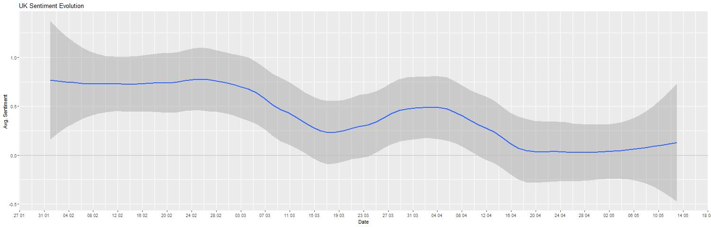
United Kingdom
Country’s Level
Interesting case due to complete change of strategy
Interestingly, sentiment started turning positive as cases started growing; it only started going down again after change of strategy and lockdown implementation
Wordcloud points to heavy focus on protection but also points towards current crisis and death
Notes:
Mid april may deaths in the uk → mai 1. peak reached
From beginning of may, sentiment starts again

Slide 14
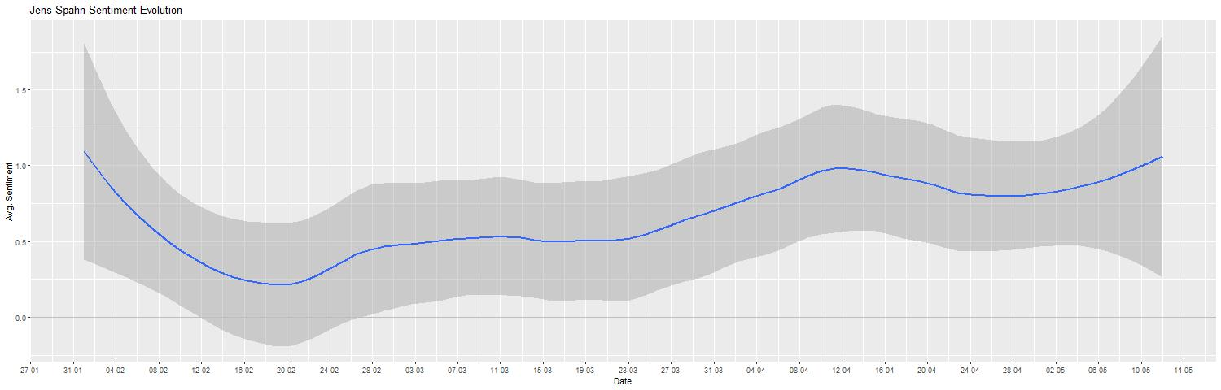
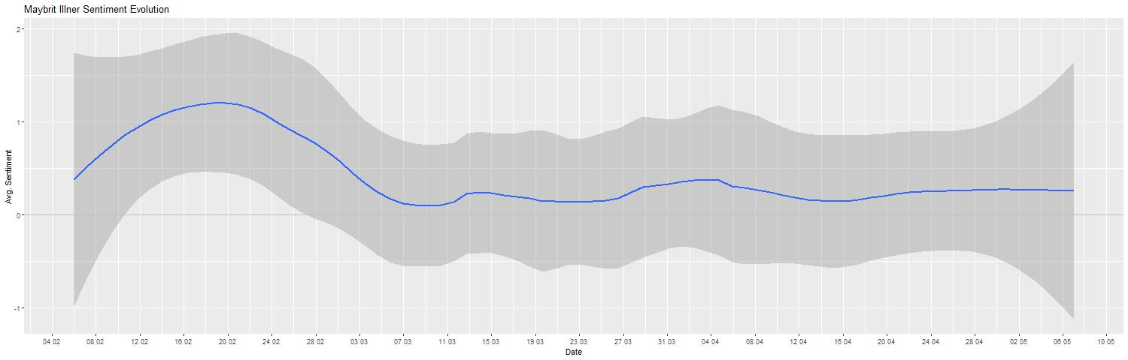
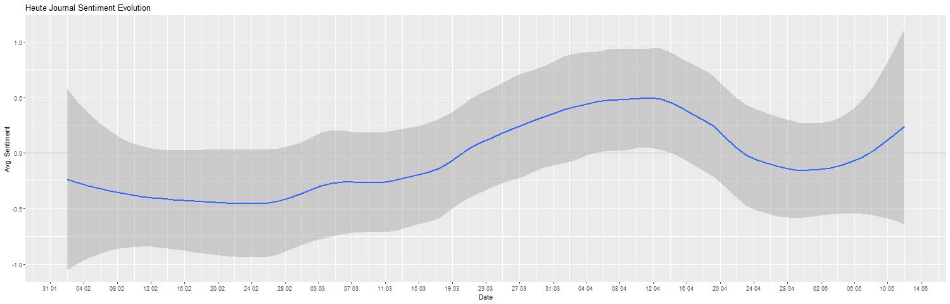
Germany
4
6
1
Opinion Leaders’ Level
2
3
5
OBSERVED PERSONS
Jens Spahn – low sentiment at the beginning and then gradually up
Maybrit Illner – up and down at the beginning and then stays close to 0
Heute Journal – stays close to 0, increase and decrease
SENTIMENT EVOLUTION
Jens Spahn‘s sentiment is contrasting with Illner’s and starts rising at the end of February; aligns with Heute Journal’s sentiment evolution
Maybrit Illner’s sentiment peaks midst of February and then stays close to zero, without big changes
Heute Journal’s sentiment goes gradually up, unlike Maybrit’s; it goes down after mid April and then rises again
IMPORTANT POINTS IN TIME/POSSIBLE TURNING POINTS
First COVID-19 case confirmed
Germanys minister of health announces that the country is at the beginning of an epidemic
WHO declares COVID-19 as a pandemic
Germany closes borders
“Contact ban” of more than two people
Germany announces plans to reopen their economy starting April 20th
Notes:
January 27 Germany confirms its first case.
February 3 Ministries of health from G7 countries agree to coordinate their responses to the outbreak.
February 13 EU health ministers convene in Brussels for an emergency health meeting on how to prevent COVID-19 from spreading in Europe.
February 26 Germany’s minister of health announces the country is “at the beginning of an epidemic.”
March 16 Germany closes its borders to non-citizens and residents.
March 22 Germany introduces a ‘contact ban’—banning groups of more than two people.
April 15 Germany announces plans to reopen their economy starting April 20. It also announces plans to resume in-person schooling on May 3.

Slide 15
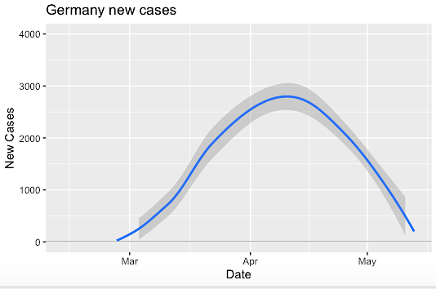
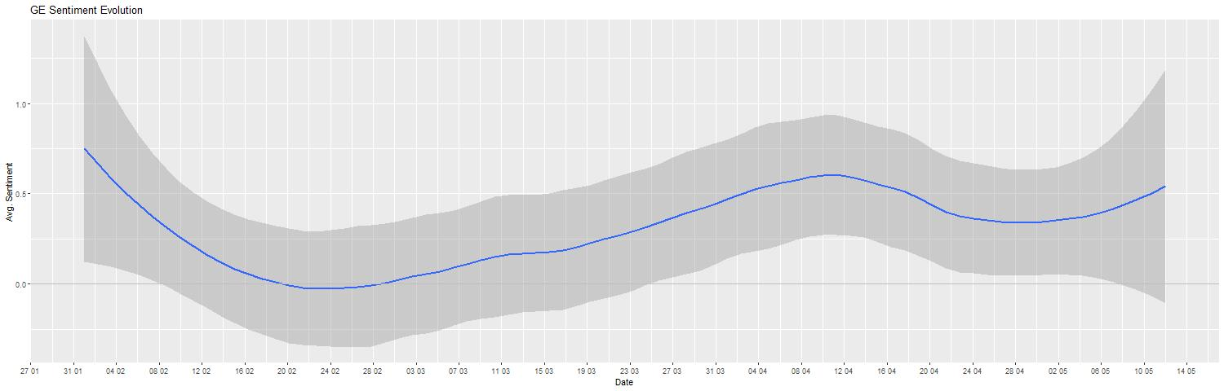

Germany
Country’s Level
There seems to be a lag between sentiment evolution and virus spread: sentiment declines before the virus starts growing, then it increases and starts declining again mid-April, until it goes back up
The sentiment probably correlates with the measures, as people feel safer when they know that something is put in place to protect them
Negative words are about the difficult time and the measures that are taken, positive words are about going through the situation together

Slide 16
Countries’ Comparison
Sentiment Analysis Across Countries
In all cases, it seems that a decrease of sentiment started before the virus actually started growing
The sentiment curves of the US and UK seem to be similar when compared to Germany, which could be explained by their similarities in the “new cases” curves
Germany seems to have dealt with the crisis faster and more effectively than the US and UK
Hypothesis – Germany realized the dangers of the virus early, compared to UK and the US
US
UK
Germany

Slide 17
Final Notes
Conclusion & Potential Extension
Limitations
Our results are mostly hypotheses, but they allow for some better understanding of the situation
Big potential for many hypotheses testing, with a bigger and more representative sample:
How the sentiment evolves during a crisis (lag or not),
How efficient are different countries’ reactions,
Who really influences the global sentiment during a crisis
…
Comparison with past disease outbreaks could give us a better understanding of how to use sentiment as a prediction for crisis development
Old and static data for network analysis
Limited data for tweets (maximum of 3,200 tweets)
Non-representativeness of our sample and risk of bias
Different languages, so difficulty of analysis
Dynamic data, as the situation is not over

Slide 18
Thank
YOU!
ANY QUESTION?

Slide 19
Appendix
Additional data

Slide 20
Donal Trump
Wordclouds & Topics

Slide 21

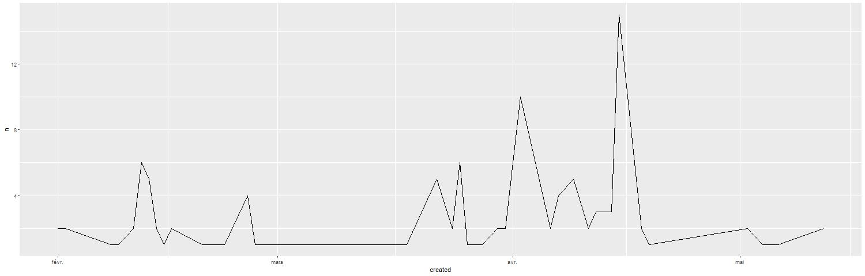

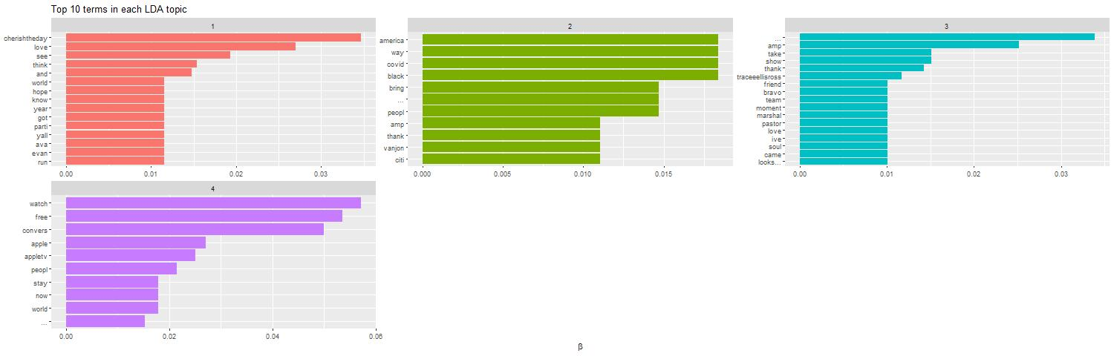
Oprah Winfrey
Wordclouds & Topics

Slide 22

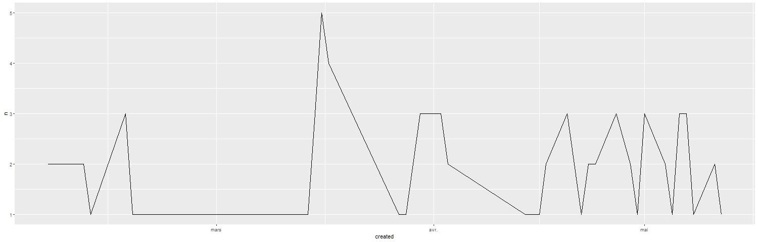

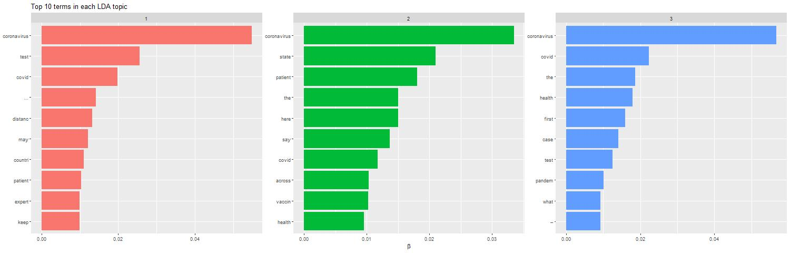
USA Today Health
Wordclouds & Topics

Slide 23

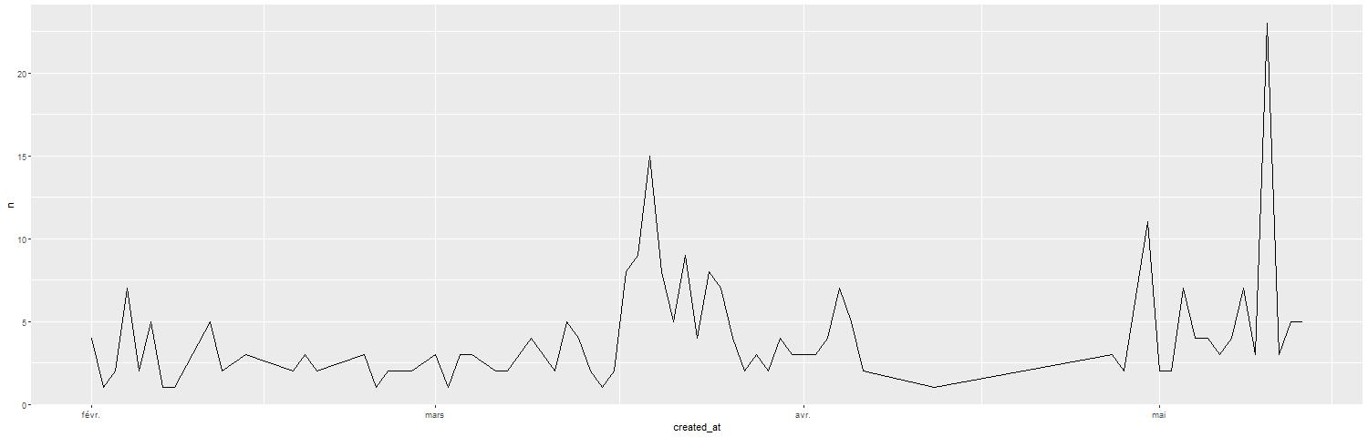

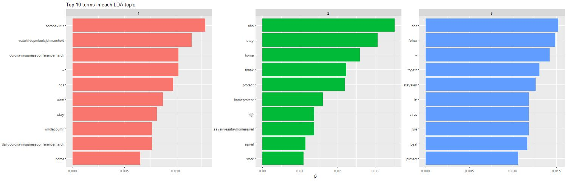
Boris Johnson
Wordcloud & Topics

Slide 24

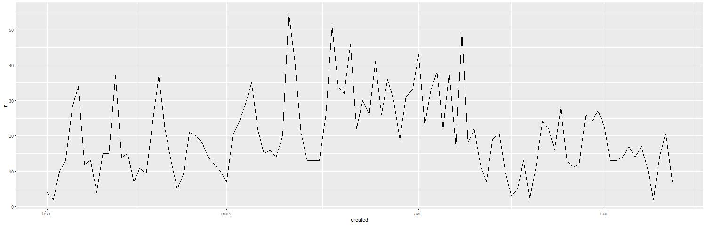

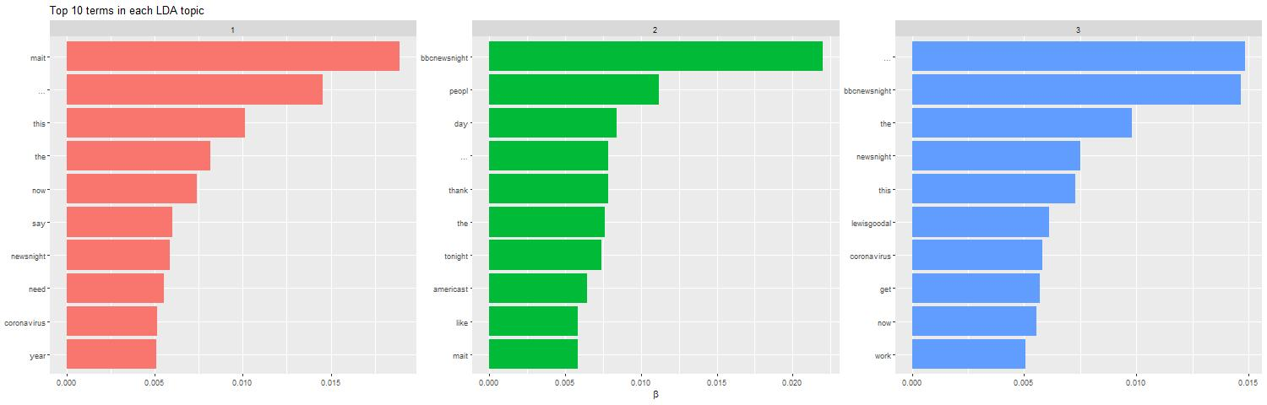
Emily Maitlis
Wordcloud & Topics

Slide 25

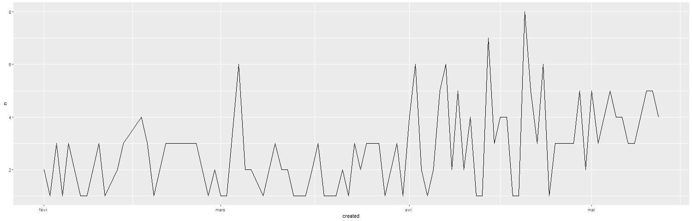

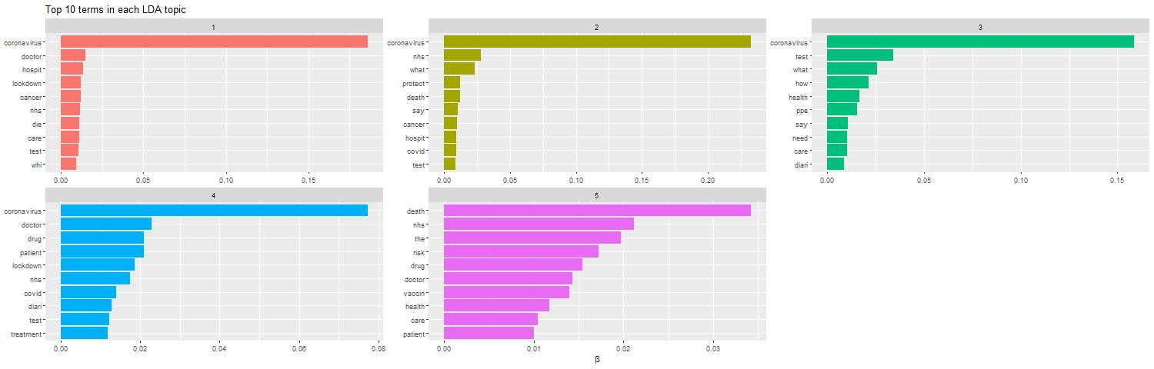
BBC Health News
Wordcloud & Topics

Slide 26

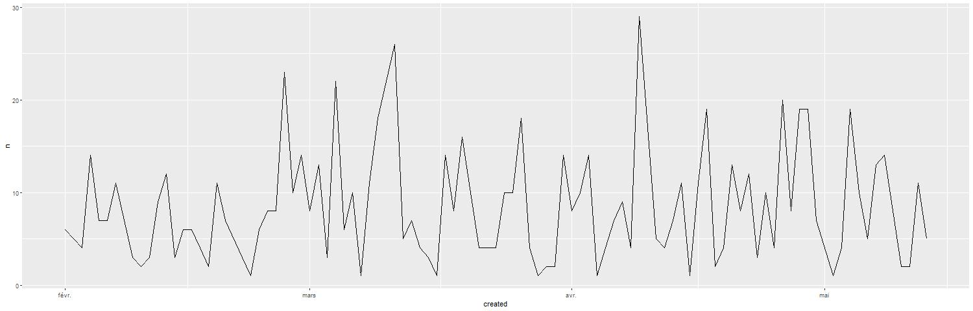

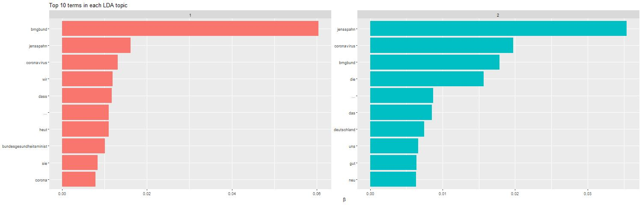
Jens Spahn
Wordcloud & Topics

Slide 27

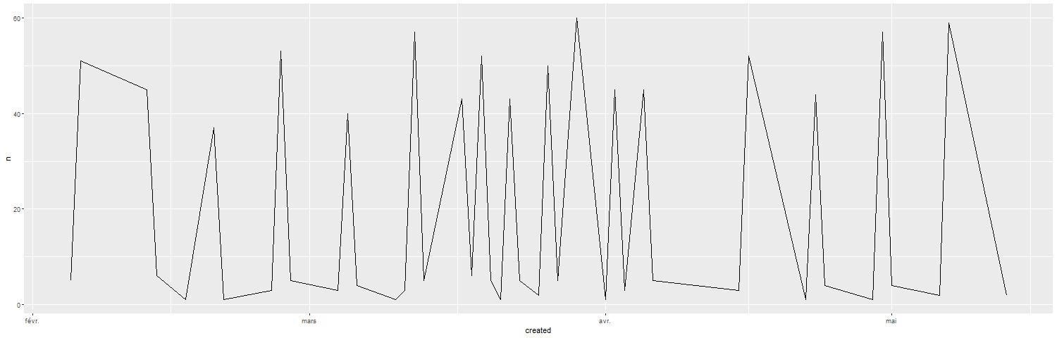

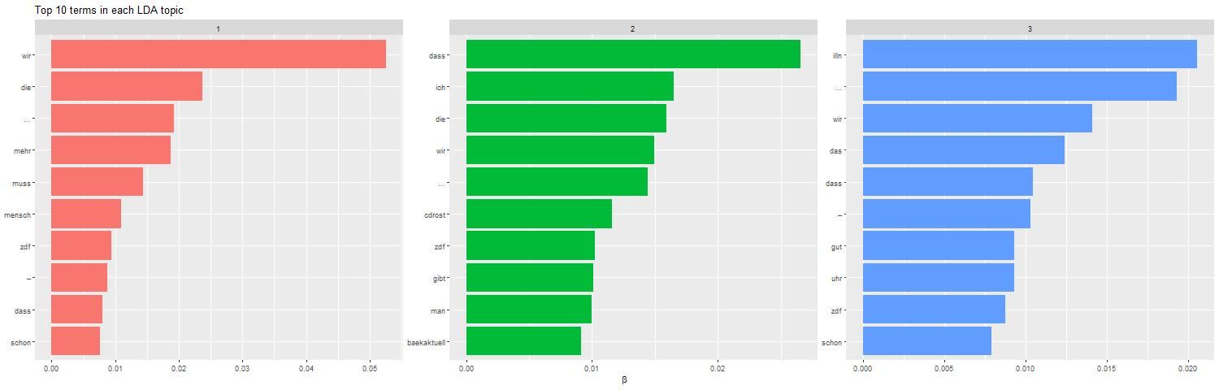
Maybritt Illner
Wordcloud & Topics

Slide 28

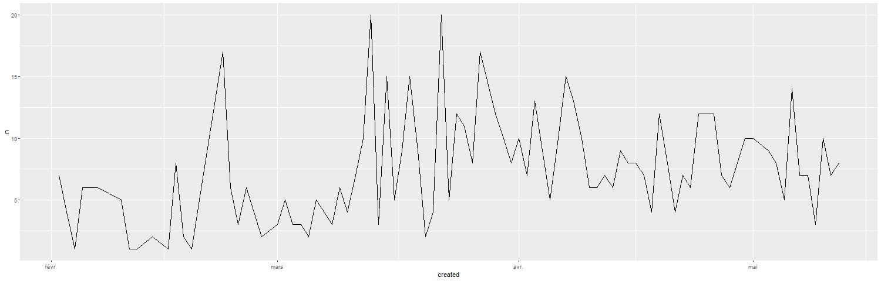

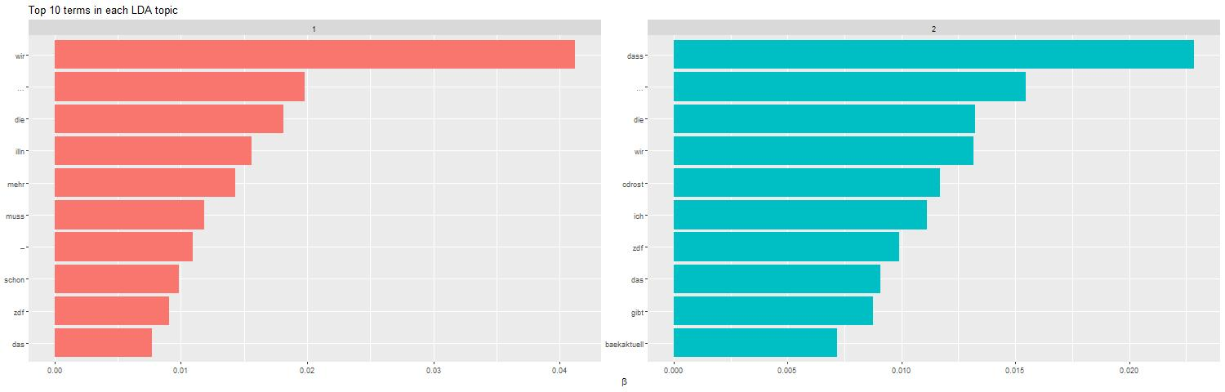
Heute Journal
Wordcloud & Topics

